Slide 1
Introduction to New Time & Attendance System for SUPERVISORS
Idalia Guzmán Guzmán , EdD
Director, Sustained Learning Program
Deanship of Administration
Medical Sciences Campus

Slide 2
Why are we changing?
Uniformity & Consistency
Automation of attendance registration
System Integration
Elimination and simplification of multiple processes

Slide 3
Advantages
Real-time information
Access to manage attendance and leave balances
Improve control over leave requests
Automatically generate leave requests
Options for attendance logging

Slide 4
Where to register attendance?
Terminal
Computer
Mobile device

Slide 5
Registering the attendance in the terminal
This card does not display a photograph or the employee’s name.
The reverse side of the card features a unique identifier, which is not the same as the employee number.
Employees are liable for the cost of replacing a lost card.
Upon termination of employment, the card must be returned to the Human Resources department.

Slide 6
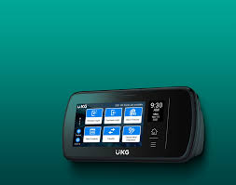
Location of the Terminals
Guillermo Arbona Building, Floor 1
Guillermo Arbona Building, Floor 2
Graduate Nursing School
College of Health Professions (EPS)
School of Pharmacy (New Building)
Clinics of the School of Medicine (PPMI)
Institute of Neurobiology, San Juan
Caribbean Primate Center, Sabana Seca

Slide 7
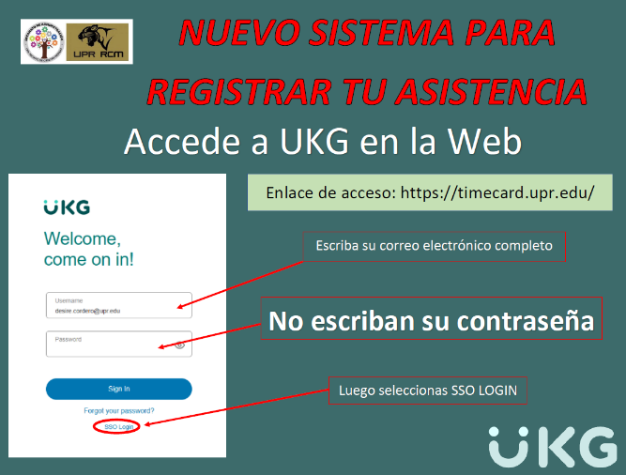
Web Access
Access Link
Write your institutional email
Do not write your password
Click SSO Login
From the App Store on your
Mobile device search for:
UKG Dimensions

Slide 8
Supervisor’s Key Responsibilities
Monitor Attendance
Manage Time Off Requests
Approve Leave
Requests Corrective Actions
Manage Timecards
Review Overtime / Compensatory Time
Employee Notifications
Submit to HR changes in schedule/supervision

Slide 9
Monitoring Attendance
Supervisors will be able to regularly monitor attendance records in the UKG System. This includes checking in to identify unexcused absences and ensuring accurate timekeeping.

Slide 10
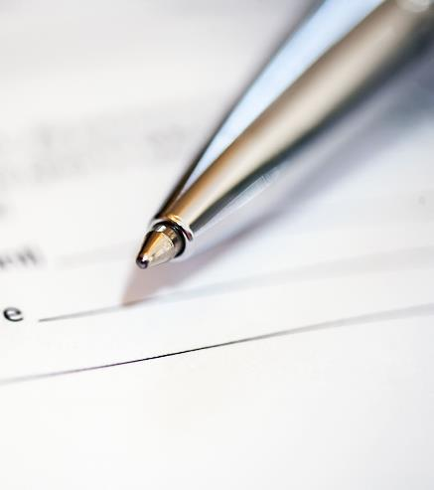
Approving Leave Requests
Supervisors are responsible for reviewing all leave requests submitted by employees through the UKG portal.
Employees must provide appropriate documentation when requesting leave. For example, a medical certificate is required for medical leaves.
Supervisors must ensure that all leave requests adhere to institutional policies.
Approval of leave requests should consider the availability of the employee’s leave balances.

Slide 11
Managing Timecards
Overview of Timecards
Supervisors must effectively manage timecards for all employees, ensuring that they are filled out correctly, and discrepancies are addressed promptly.
Addressing Discrepancies
If timecards contain errors, supervisors need to review and correct these promptly to maintain accurate payroll processing.
Finalizing Timecards
At the end of each pay period, supervisors are responsible for certifying and submitting employee timecards to HR, which is crucial for accurate payroll calculations.

Slide 12
You will receive notifications to your email and/or mobile device
When an employee has a missing punch.
When an employee approves their timecard.
When an employee removes or deletes a record.
If you do not approve your employees' timecards, you will receive a notification until you complete the task.
When an employee works overtime.
When an employee requests vacation or any other license.

Slide 13
UKG VIDEO TUTORIALS

Slide 14
ACCESS EMPLOYEE TIMECARD: How to access employee Timecards

Slide 15
COMMETS AND NOTES TO TIMECARD: How to add comments and notes

Slide 16
APPROVE A TIMECARD: How to confirm paycodes and approve an individual timecard

Slide 17
REMEMBER
Before the end of the pay period, review and approve or deny leave requests and all justifications (comments) submitted by your employees.
IMPORTANT: At the end of each month, there is a five (5) days period to approve your employees' timecards. After this period, the records will be closed.

Slide 18
Registration for the new system begins:
March 3, 2025

Slide 19
IMPORTANT
To look up the balances, request vacations, and modify the timecard, among other functionalities of the new UKG Dimensions attendance registration system, it is essential that your institutional email is activated and that you can access it with your password.
If you have not yet activated your institutional email or have difficulties accessing it, you should visit the Office Information Systems (OSI) as soon as possible. In the Technical Support area, staff will be available to assist you in this process. The service hours are from Monday to Friday from 8:00 AM to 4:00 PM.

Slide 20
Contact for Queries
Resources for Assistance
For any queries related to the UKG system, contact via email: ukgconsultas.rcm@upr.edu or contact Mrs. Rosa Liz Jiménez Suárez, Principal Liaison for the UKG Time and Attendance Project with Central Administration.
You can reach out for troubleshooting or any issues encountered in the UKG portal.

